Slide 1
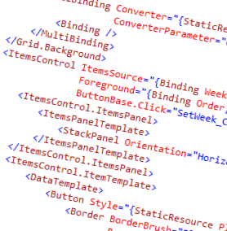
WPF and XAML
6 - Data Binding

Slide 2
Overview
What is data binding?
Sources and targets
DataContext
Binding Modes
Updating the UI
Controlling update timing
Converters

Slide 3








Person
Name
▪

Slide 4














Slide 5












Person
Name
Address
Number
Street

Slide 6






























Slide 7
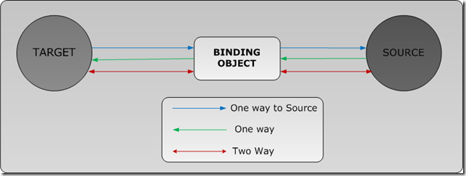
The Binding Object
A binding creates a Binding object under the covers
This object manages the communication

Slide 8
















Slide 9















Slide 10











Slide 11
Summary
Data binding is an extremely powerful part of XAML
If you bind to a control, the property must be a dependency property (not if you are making user controls)
Value converters are provided if the data type needs conversion during the binding

Slide 12
Demo
Various data binding demonstrations

